Slide 1
Flask-HTTPAuth
Simple extension that provides
Basic and Digest HTTP
authentication for Flask routes

Slide 2
Flask-HTTPAuth Use Case

Slide 3
What does it do?
Hides the protocol details of the HTTP authentication protocol
The server requests authentication information (i.e. username and password) to allow access
Digest Authentication communicates credentials in an encrypted form

Slide 4
Mini-Tutorial
Create a new project
Install Flask: pip install Flask
Install Flask-HTTPAuth: pip install Flask-HTTPAuth
**HTTPAuth contains both HTTPBasicAuth and HTTPDigestAuth

Slide 5
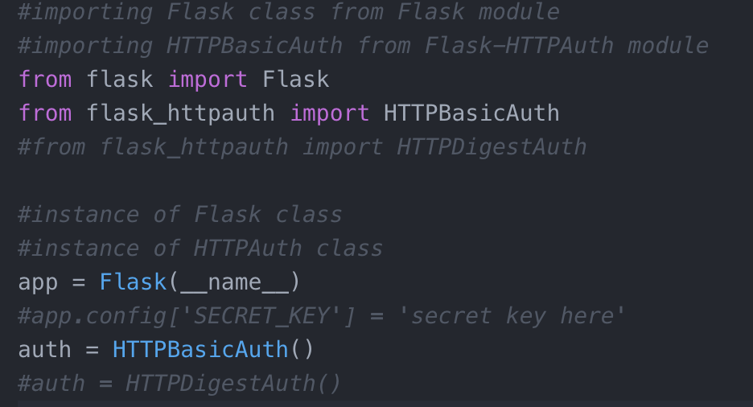
Getting started with Flask-HTTPBasicAuth or Flask-HTTPDigestAuth
**The secret key is used for encryption for HTTPDigestAuth

Slide 6
Define the users

Slide 7
get_password callback
Flask-HTTP will allow access if and only if get password(username) == password

Slide 8
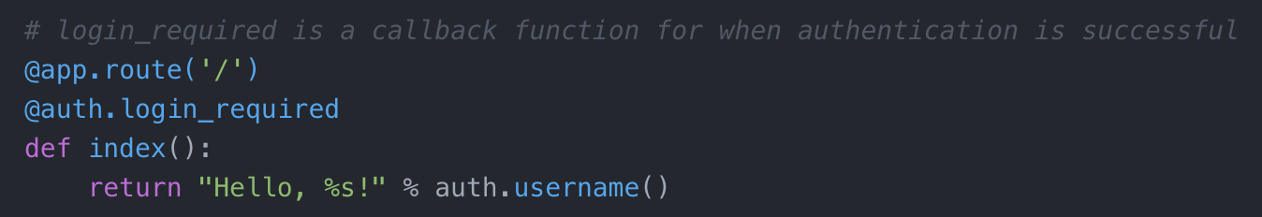
login_required
login_required is usually a Flask view function
.username() accesses the logged username

Slide 9
Let’s see this in action!

Slide 10
Resources for further reading:
https://flask-httpauth.readthedocs.io/en/latest/
https://github.com/humiaozuzu/awesome-flask
https://www.httpwatch.com/httpgallery/authentication/
https://github.com/miguelgrinberg/Flask-HTTPAuth

